Slide 1
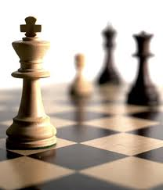


人工智能
罗平 luop@ict.ac.cn

Slide 2

Knowledge 4

Slide 3
First-Order Logic: Inference

Slide 4
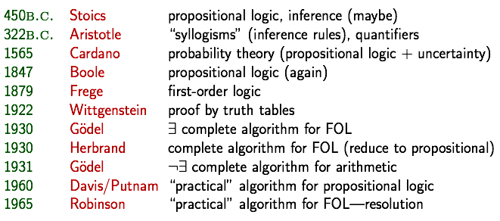
A brief history of reasoning

Slide 5
First-Order Logic: Inference
Resolution in FOL

Slide 6
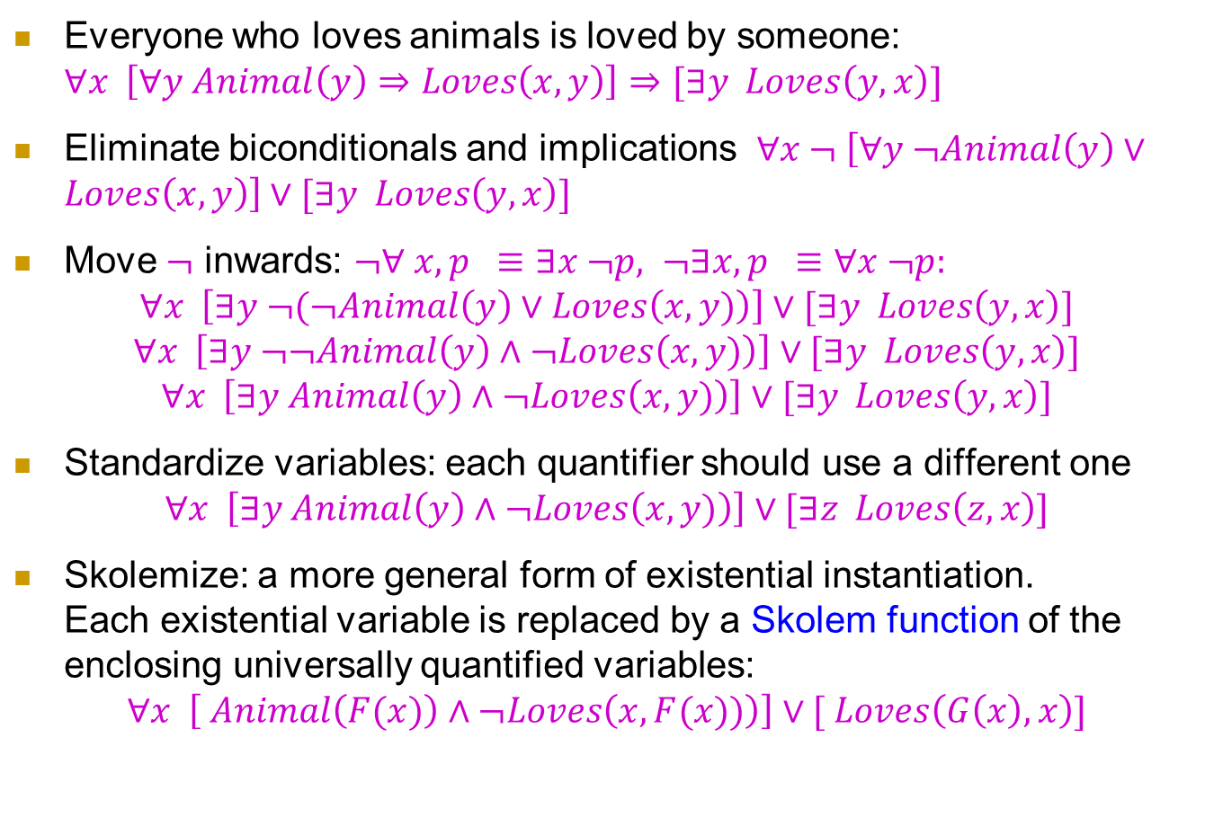
Conversion to CNF
Everyone who loves animals is loved by someone: $∀x \left[∀y Animal\left(y\right)⇒Loves\left(x,y\right)\right]⇒[∃y Loves\left(y,x\right)]$
Eliminate biconditionals and implications $∀x ¬ \left[∀y ¬Animal\left(y\right)∨Loves\left(x,y\right)\right]∨[∃y Loves\left(y,x\right)]$
Move $¬$ inwards: $¬∀ x, p ≡∃x ¬p, ¬∃x,p ≡∀x ¬p:$
$$∀x \left[∃y ¬(¬Animal\left(y\right)∨Loves\left(x,y)\right)\right]∨[∃y Loves\left(y,x\right)]$$
$$∀x \left[∃y ¬¬Animal\left(y\right)∧¬Loves\left(x,y)\right)\right]∨[∃y Loves\left(y,x\right)]$$
$$∀x \left[∃y Animal\left(y\right)∧¬Loves\left(x,y)\right)\right]∨[∃y Loves\left(y,x\right)]$$
Standardize variables: each quantifier should use a different one
$$∀x \left[∃y Animal\left(y\right)∧¬Loves\left(x,y)\right)\right]∨[∃z Loves\left(z,x\right)]$$
Skolemize: a more general form of existential instantiation. Each existential variable is replaced by a Skolem function of the enclosing universally quantified variables:
$$∀x \left[ Animal\left(F(x)\right)∧¬Loves\left(x,F(x))\right)\right]∨[ Loves\left(G\left(x\right),x\right)]$$

Slide 7

Conversion to CNF
Drop universal quantifiers:
$$\left[ Animal\left(F(x)\right)∧¬Loves\left(x,F(x)\right)\right]∨[ Loves\left(G(x),x\right)]$$
Distribute $∧$ over $∨$ :
$$\left[ Animal\left(F(x)\right)∨Loves\left(G(x),x)\right)\right]∧[¬Loves\left(x,F(x)\right)∨Loves\left(G(x),x\right)]$$

Slide 8
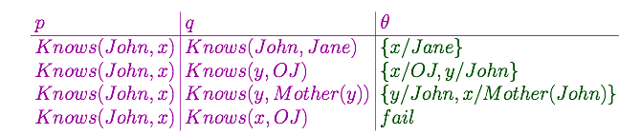

Unification
We can get the inference immediately if we can find a substitution $θ$ such that $King(x)$ and $Greedy(x)$ match $King(John)$ and $Greedy(y)$
$θ=\{x/{John},y/{John\}}$ works
$UNIFY\left(α,β\right)=θ$ if $αθ equals to βθ$
$$\text{Standardizing} \text{apart} \text{eliminates} \text{overlap} \text{of} \text{variables}\text{, }\text{e}\text{.}\text{g}\text{., }K\text{nows} \left(z_{17},OJ\right)$$

Slide 9


Resolution: brief summary
Full first-order version
Where $UNIFY\left(l_{i},¬m_{j}\right)=θ$
For example,
With $θ=\{x/{Ken}\}$
Apply resolution steps to CNF(KB$∧¬α$); complete for FOL
$$\frac{l_{1}∨…∨l_{k}, m_{1}∨…∨m_{n}}{(l_{1}∨…∨l_{i−1}∨l_{i+1}∨…∨l_{k}∨m_{1}∨…∨m_{j−1}∨m_{j+1}∨…∨m_{n})θ}$$
$$\frac{¬Rich\left(x\right)∨Unhappy\left(x\right) , Rich\left(Ken\right)}{Unhappy(Ken) }$$

Slide 10
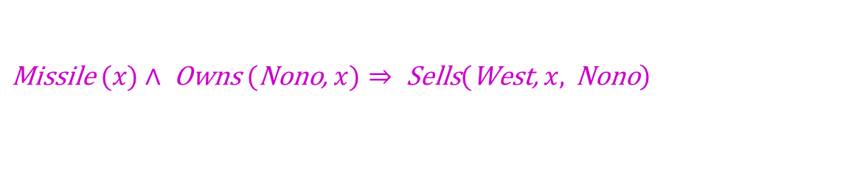
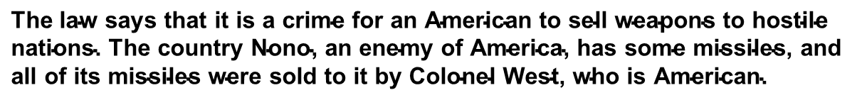
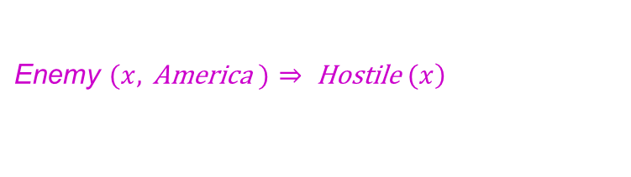

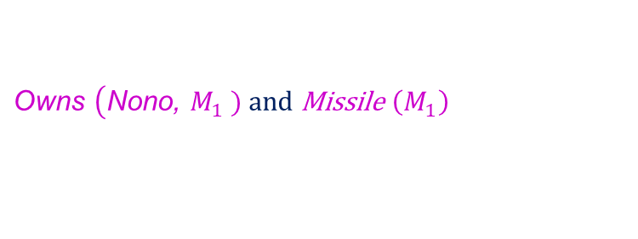
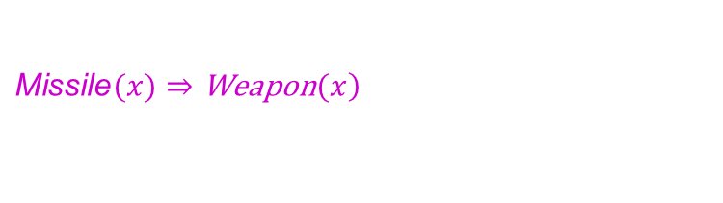
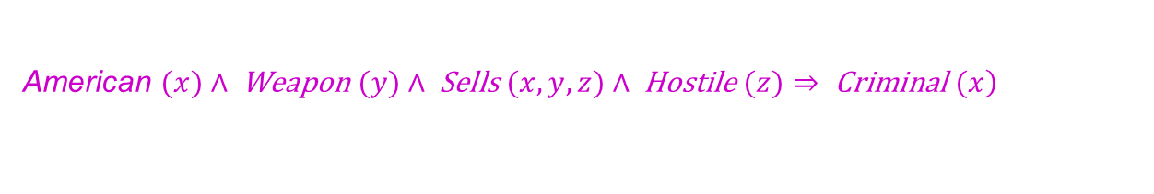

Example knowledge base
$$\text{The} \text{law} \text{says} \text{that} \text{it} \text{is} \text{a} \text{crime} \text{for} \text{an} \text{American} \text{to} \text{sell} \text{weapons} \text{to} \text{hostile} \text{nations}\text{. }\text{The} \text{country} \text{Nono}\text{, }\text{an} \text{enemy} \text{of} \text{America}\text{, }\text{has} \text{some} \text{missiles}\text{, }\text{and} \text{all} \text{of} \text{its} \text{missiles} \text{were} \text{sold} \text{to} \text{it} \text{by} \text{Colonel} \text{West}\text{, }\text{who} \text{is} \text{American}\text{.}$$
Prove that Col. West is a criminal
… it is a crime for an American to sell weapons to hostile nations:
$$\left. \text{American} (x)∧ \text{Weapon} (y)∧ \text{Sells} (x,y,z)∧ \text{Hostile} (z)⇒ \text{Criminal} (x\right)$$
$$\text{Nono} … \text{has} \text{some} \text{missiles}\text{, }\text{i}\text{.}\text{e}\text{., }∃x \text{Owns} (\text{Nono}\text{, }x)∧\text{Missile}(\text{x})\text{ : }$$
$$\text{Owns} \left(\text{Nono}\text{, }M_{1}\right. \text{) }\text{and} \text{Missile} \left(M_{1}\right)$$
$$\text{...} \text{all} \text{of} \text{its} \text{missiles} \text{were} \text{sold} \text{to} \text{it} \text{by} \text{Colonel} \text{West}$$
$$\left.\text{Missile} (x)∧ \text{Owns} (\text{Nono}\text{, }x)⇒ \text{Sells}(\text{West}\text{, }x, \text{Nono}\right)$$
$$\text{Missiles} \text{are} \text{weapons}\text{: }$$
$$\left.\text{Missile}(x)⇒\text{Weapon}(x\right)$$
$$\text{An} \text{enemy} \text{of} \text{America} \text{counts} \text{as}\text{ "}\text{hostile}\text{"}:$$
$$\left.\text{Enemy} (x, \text{America} )⇒ \text{Hostile} (x\right)$$
$$\text{West}\text{, }\text{who} \text{is} \text{American} ...$$
$$\left.\text{American}(\text{West}\right)$$
$$\text{The} \text{country} \text{Nono}\text{, }\text{an} \text{enemy} \text{of} \text{America} …$$
$$\text{Enemy}\text{ (}\text{Nono}\text{, }\text{America}\text{) }$$

Slide 11
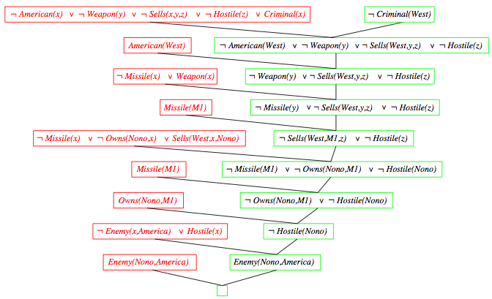

Resolution proof
$$¬$$

Slide 12
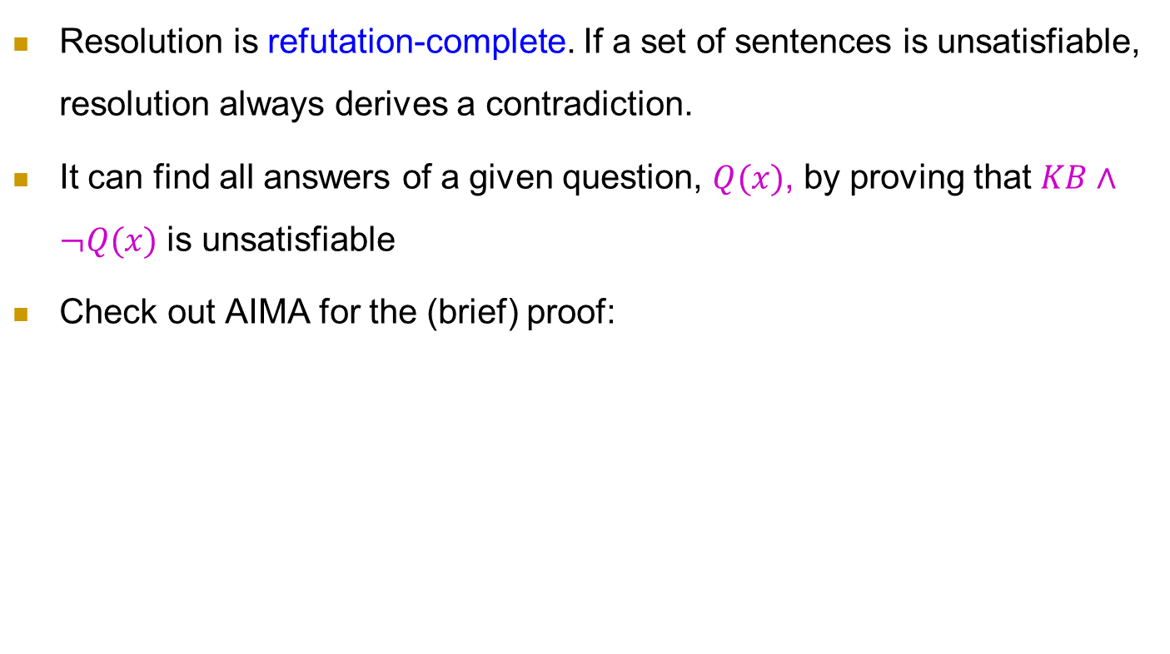
Completeness of FOL resolution
Resolution is refutation-complete. If a set of sentences is unsatisfiable, resolution always derives a contradiction.
It can find all answers of a given question, $Q(x)$, by proving that $KB∧¬Q(x)$ is unsatisfiable
Check out AIMA for the (brief) proof:
If S is an unsatisfiable set of clauses, then the application of a finite number of resolution steps to S will yield a contradiction

Slide 13
归结策略
删除和限制

Slide 14
归结策略：广度优先
策略定义：状态、目标状态
例设有如下子句集：S={﹁I(x)∨R(x), I(a), ﹁R(y)∨L(y), ﹁L(a) }
用广度优先策略证明S为不可满足。
广度优先策略的归结树如下：
S0
﹁I(x)∨R(x)
I(a)
﹁R(y)∨L(y)
﹁L(a)
S1
R(a)
﹁I(x) ∨L(x)
﹁R(a)
S2
L(a)
L(a)
﹁I(a)
﹁I(a)
NIL

Slide 15
归结策略：广度优先
广度优先策略的优点：
当问题有解时保证能找到最短归结路径。
是一种完备的归结策略。
广度优先策略的缺点：
归结出了许多无用的子句
既浪费时间，又浪费空间
广度优先对大问题的归结容易产生组合爆炸，但对小问题却仍是一种比较好的归结策略。

Slide 16
归结策略
常用的归结策略可分为两大类:
删除策略是通过删除某些无用的子句来缩小归结范围
限制策略是通过对参加归结的子句进行某些限制，来减少归结的盲目性，以尽快得到空子句。

Slide 17
删除策略：删除纯文字
删除法主要想法是：把子句集中无用的子句删除掉，这就会缩小搜索范围，减少比较次数，从而提高归结效率。
纯文字删除法
如果某文字L在子句集中不存在可与其互补的文字﹁L，则称该文字为纯文字。
在归结过程中，纯文字不可能被消除，用包含纯文字的子句进行归结也不可能得到空子句
对子句集而言，删除包含纯文字的子句，是不影响其不可满足性的。例如，对子句集 S={P∨Q∨R, ﹁Q∨R, Q, ﹁R}, 其中P是纯文字，因此可以将子句P∨Q∨R从子句集S中删除。

Slide 18
删除策略：删除重言式
重言式删除法
如果一个子句中包含有互补的文字对，则称该子句为重言式。
例如P(x)∨﹁P(x), P(x)∨Q(x)∨﹁P(x) 都是重言式，不管P(x)的真值为真还是为假，P(x)∨﹁P(x)和P(x)∨Q(x)∨﹁P(x)都均为真。
重言式(valid sentences)是真值为真的子句。对一个子句集来说，不管是增加还是删除一个真值为真的子句，都不会影响该子句集的不可满足性。因此，可从子句集中删去重言式。

Slide 19
限制策略：支持集策略
支持集策略（Set of support）：
每一次参加归结的两个亲本子句中，至少应该有一个是由目标公式的否定所得到的子句或它们的后裔。
支持集策略是完备的(?)，即当子句集为不可满足时，则由支持集策略一定能够归结出一个空子句。
也可以把支持集策略看成是在广度优先策略中引入了某种限制条件，这种限制条件代表一种启发信息，因而有较高的效率

Slide 20
限制策略：支持集策略
目标公式的否定
﹁I(x)∨R(x)
I(a)
﹁ R(y)∨L(y)
﹁L(a)
R(a)
﹁I(x)∨L(x)
L(a)
L(a)
﹁I(a)
NIL

Slide 21
限制策略：支持集策略
支持集策略限制了子句集元素的剧增，但会增加空子句所在的深度（结果可能不是最优）。
支持集策略具有逆向推理的含义，由于进行归结的亲本子句中至少有一个与目标子句有关，因此推理过程可以看作是沿目标、子目标的方向前进的。

Slide 22
限制策略:单文字子句策略
如果一个子句只包含一个文字，则称此子句为单文字子句。单文字子句策略是对支持集策略的进一步改进，它要求每次参加归结的两个亲本子句中至少有一个子句是单文字子句。
采用单文字子句策略，归结式包含的文字数将少于其非单文字亲本子句中的文字数，这将有利于向空子句的方向发展，因此会有较高的归结效率。

Slide 23
限制策略:单文字子句策略
例: 设有如下子句集：
S={﹁I(x)∨R(x), I(a), ﹁R(y)∨L(y), ﹁L(a) }
用单文字子句策略证明S为不可满足。
﹁I(x)∨R(x)
I(a)
﹁R(y)∨L(y)
﹁L(a)
R(a)
﹁R(a)
NIL

Slide 24
限制策略:单文字子句策略
单文字子句策略是不完备的，即当子句集为不可满足时，用这种策略不一定能归结出空子句。
原因： 没有可用的单文字字句
例如：已知：A∨B, A∨﹁ B, ﹁A ∨ B， 求证：A∧B
化为字句集后为： A∨B, A∨﹁ B, ﹁A ∨ B，﹁A∨﹁B，不存在单文字的字句。但是可以消解出空。
A∨B
A∨﹁ B
﹁A∨﹁B
A
﹁A ∨ B
﹁B
B
NIL

Slide 25
限制策略:祖先过滤策略
祖先过滤策略(Ancestry Filtering)：满足以下两个条件中的任意一个就可进行归结：
两个亲本子句中至少有一个是初始子句集中的子句。
如果两个亲本子句都不是初始子句集中的子句，则一个子句应该是另一个子句的先辈子句。
祖先过滤策略是完备的

Slide 26
限制策略:祖先过滤策略
例：设有如下子句集：
S={﹁Q(x)∨﹁P(x), Q(y)∨﹁P(y)，﹁Q(w)∨P(w) , Q(a)∨P(a) }
用祖先过滤策略证明S为不可满足
﹁Q(x)∨ ﹁P(x)
Q(y)∨﹁P(y)
﹁ P(x)
﹁ Q(w)∨P(w)
﹁ Q(w)
Q(a)∨P(a)
P(a)
NIL

Slide 27
First-Order Logic: Inference
Generalized Modus Ponens

Slide 28
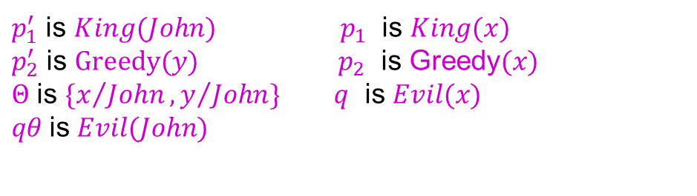
Generalized Modus Ponens (GMP) 前见推理
$\frac{p_{1}^{′},p_{2}^{′},…,p_{n}^{′}, (p_{1}∧p_{2}∧…∧p_{n}⇒q)}{qθ}$ where $p_{i}^{′}θ equals to p_{i}θ$ for all $i$
$p_{1}^{′}$ is $King(John)$ $p_{1}$ is $King(x)$
$p_{2}^{′}$ is $Greedy(y)$ $p_{2}$ is Greedy$(x)$
$Θ$ is $\{x/{John},y/{John}\}$ $q$ is $Evil(x)$
$qθ$is $Evil(John)$
GMP used with KB of definite clauses (exactly one positive literal) All variables assumed universally quantified

Slide 29
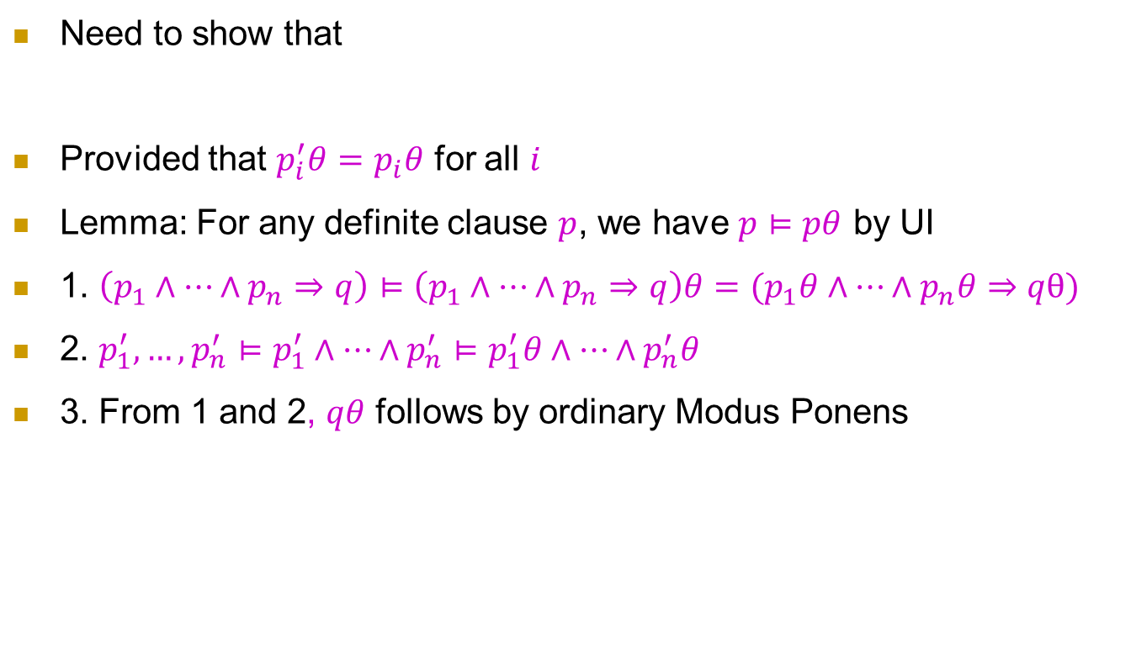
Soundness of GMP
Need to show that
Provided that $p_{i}^{′}θ=p_{i}θ$ for all $i$
Lemma: For any definite clause $p$, we have $p⊨pθ$ by UI
1. $\left(p_{1}∧…∧p_{n}⇒q\right)⊨\left(p_{1}∧…∧p_{n}⇒q\right)θ=(p_{1}θ∧…∧p_{n}θ⇒qθ)$
2. $p_{1}^{′},…,p_{n}^{′}⊨p_{1}^{′}∧…∧p_{n}^{′}⊨p_{1}^{′}θ∧…∧p_{n}^{′}θ$
3. From 1 and 2, $qθ$ follows by ordinary Modus Ponens
$$p_{1}^{′},…,p_{n}^{′}, \left(p_{1}∧…∧p_{n}⇒q\right)⊨qθ$$
The conclusion follows with the soundness of ordinary Modus Ponens

Slide 30
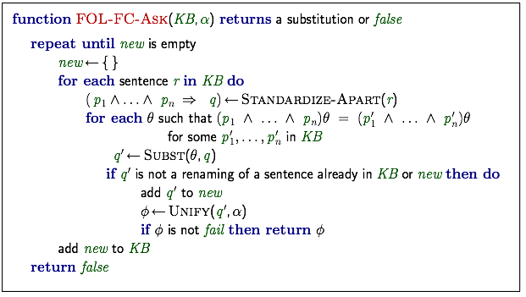
Forward chaining algorithm

Slide 31
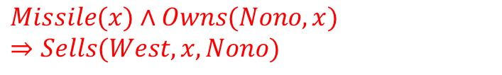








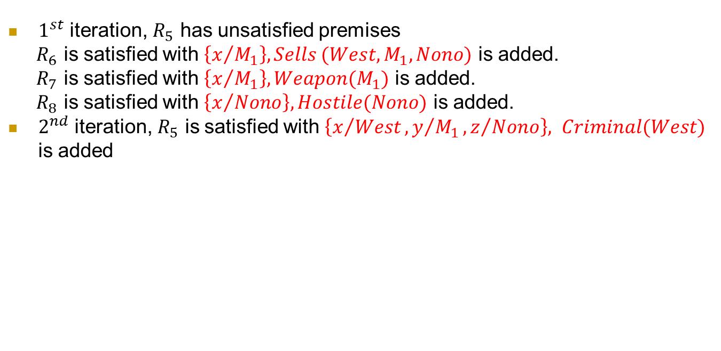






Forward chaining proof
Implications
Facts
$R_{5}$
$$American\left(x\right)∧Weapon\left(y\right)∧Sells\left(x,y,z\right)∧Hostile(z)⇒Criminal(x)$$
$R_{1}$
$\text{Owns}\text{(}\text{Nono}\text{, }M_{1}$)
$R_{2}$
$$\text{Missile} \left(M_{1}\right)$$
$R_{6}$
$$Missile(x)∧Owns(Nono,x)⇒Sells(West,x,Nono)$$
$R_{3}$
$$American(West)$$
$R_{4}$
$$Enemy(Nono,America)$$
$R_{7}$
$$Missile(x)⇒Weapon(x)$$
$R_{8}$
$$Enemy(x,America)⇒Hostile(x)$$
$1^{st}$ iteration, $R_{5}$ has unsatisfied premises
$R_{6}$ is satisfied with $\left\{x/{M_{1}}\right\}, Sells (West, M_{1},Nono)$ is added.
$R_{7}$ is satisfied with $\left\{x/{M_{1}}\right\}, Weapon(M_{1})$ is added.
$R_{8}$ is satisfied with $\left\{x/{Nono}\right\}, Hostile(Nono)$ is added.
$2^{nd}$ iteration, $R_{5}$ is satisfied with $\left\{x/{West},y/{M_{1}},z/{Nono}\right\}, Criminal(West)$ is added

Slide 32
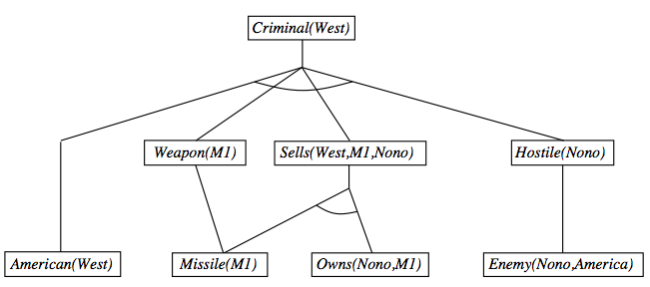
Forward chaining proof

Slide 33
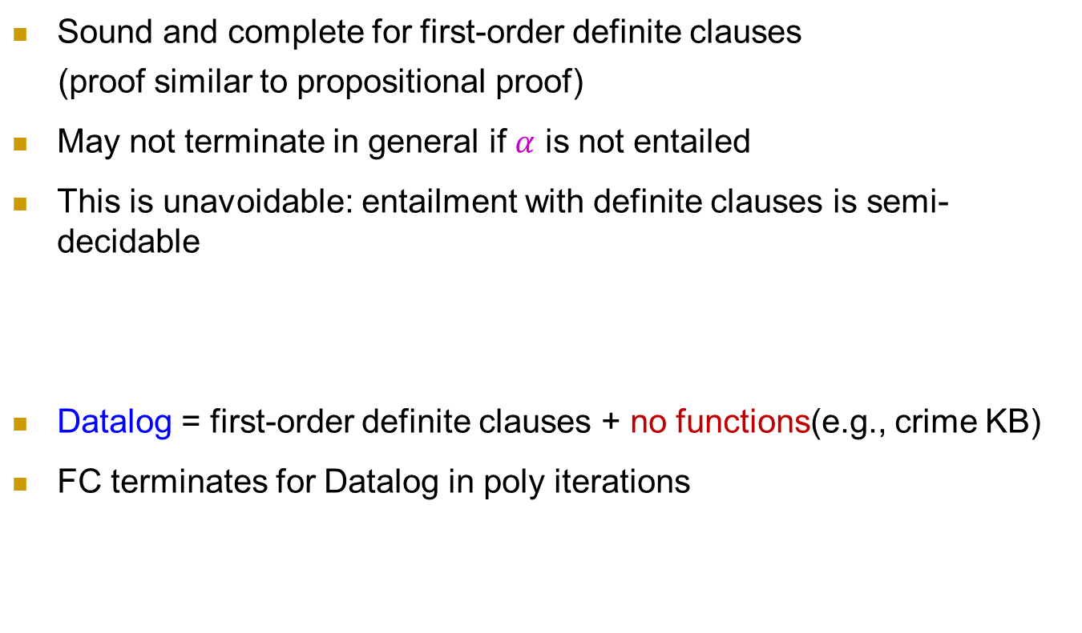
Properties of forward chaining
Sound and complete for first-order definite clauses
(proof similar to propositional proof)
May not terminate in general if $α$ is not entailed
This is unavoidable: entailment with definite clauses is semi-decidable
Datalog = first-order definite clauses + no functions(e.g., crime KB)
FC terminates for Datalog in poly iterations

Slide 34
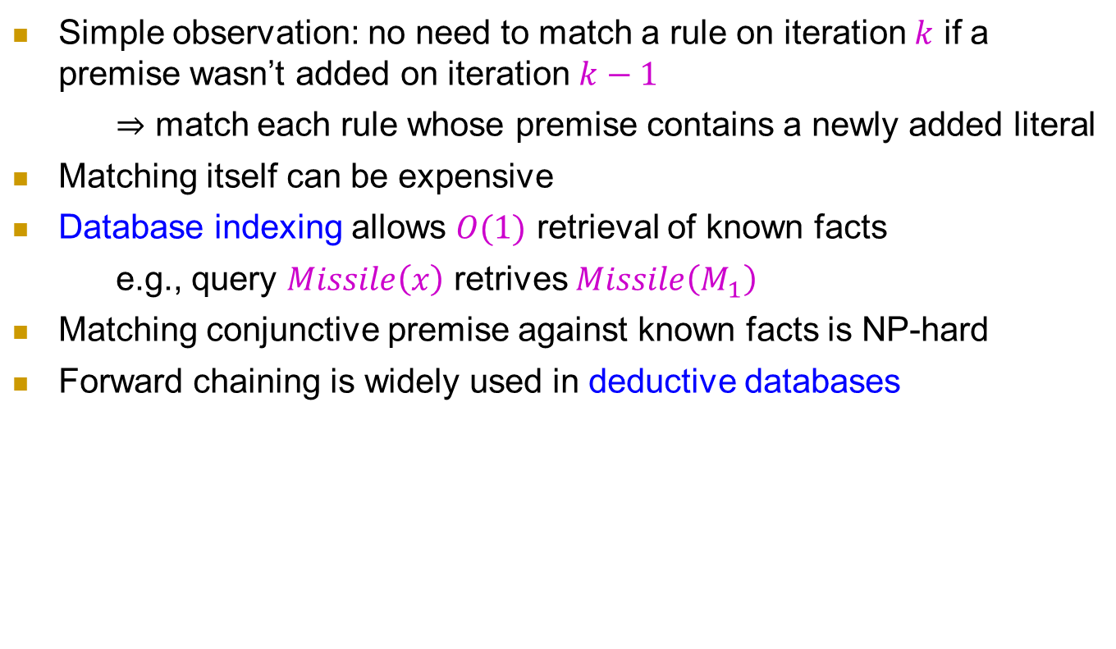
Efficiency of forward chaining
Simple observation: no need to match a rule on iteration $k$ if a premise wasn’t added on iteration $k−1$
$⇒$ match each rule whose premise contains a newly added literal
Matching itself can be expensive
Database indexing allows $O(1)$ retrieval of known facts
e.g., query $Missile\left(x\right)$ retrives $Missile\left(M_{1}\right)$
Matching conjunctive premise against known facts is NP-hard
Forward chaining is widely used in deductive databases

Slide 35
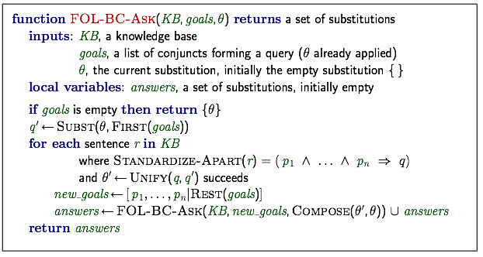
Backward chaining algorithm

Slide 36
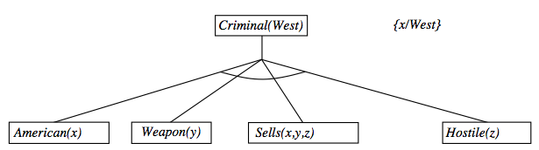
Backward chaining example

Slide 37
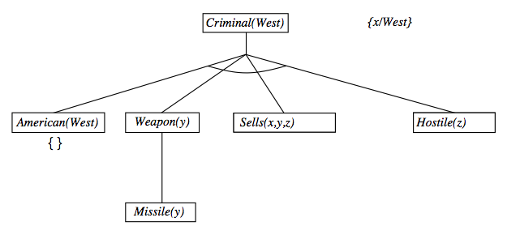
Backward chaining example

Slide 38
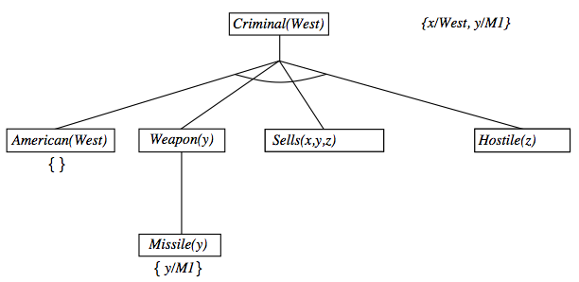
Backward chaining example

Slide 39
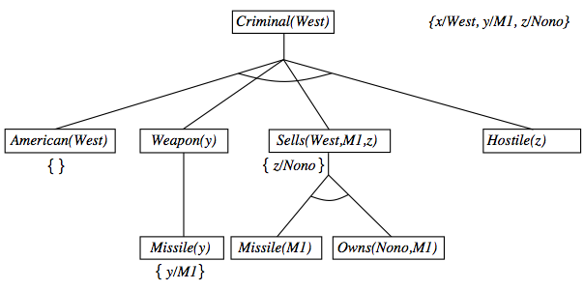
Backward chaining example

Slide 40
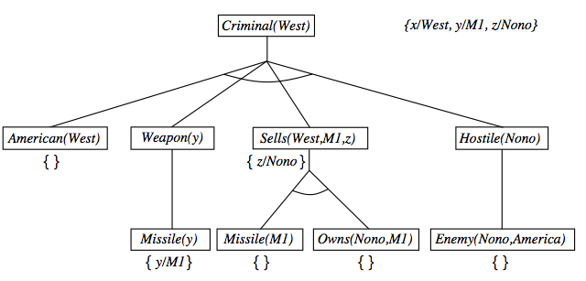
Backward chaining example

Slide 41
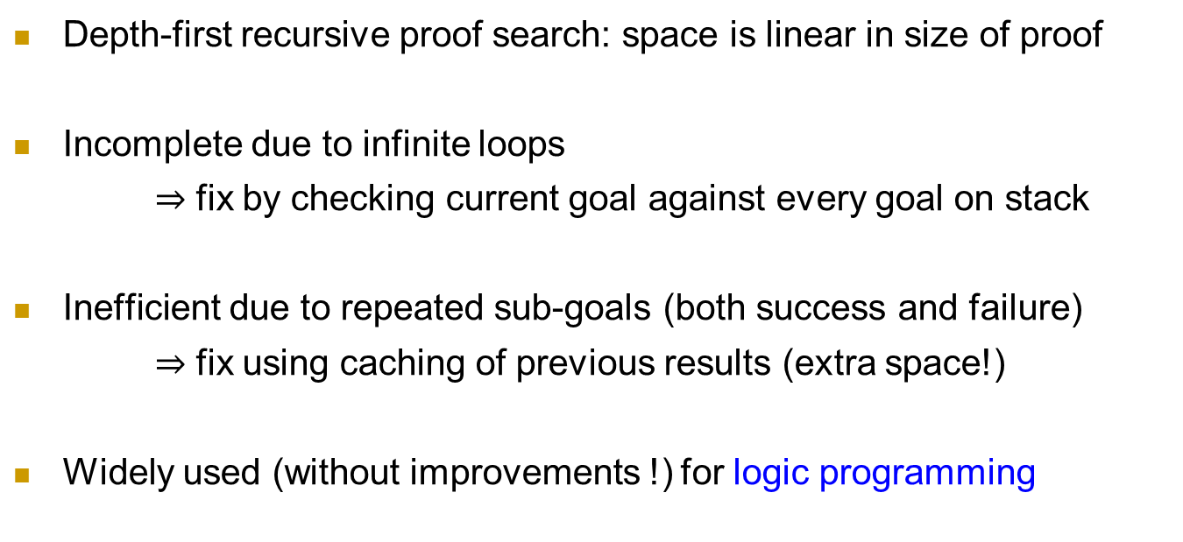
Properties of backward chaining
AND-OR search: AND for all premises; OR since the goal query can be proved by any rules
Depth-first recursive proof search: space is linear in size of proof
Incomplete due to infinite loops
$⇒$ fix by checking current goal against every goal on stack
Inefficient due to repeated sub-goals (both success and failure)
$⇒$ fix using caching of previous results (extra space!)
Widely used (without improvements !) for logic programming

Slide 42
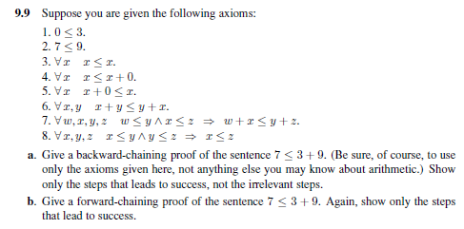
Homework
Reading Chapter 8.4

Slide 43
Logic Programming: Prolog

Slide 44
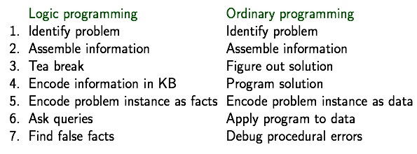

Logic programming
Sound bite: computation as inference on logical KBs
Should be easier to debug $Capital\left(NewYork,US\right)$ than $x≔x+2$

Slide 45
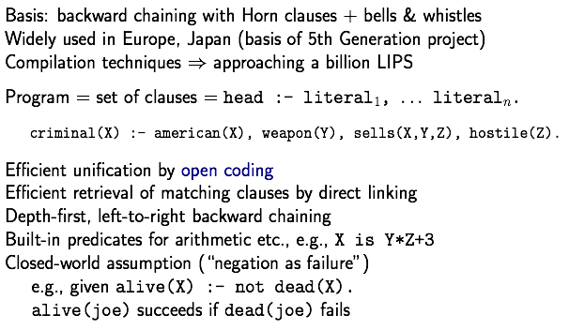
Prolog systems

Slide 46
Prolog examples
Depth-first search from a start state X:
dfs(X) :— goal(x).
dfs(X) :— successor(X,S),dfs(S).
No need to loop over S: successor succeeds for each
Appending two lists to produce a third:
append({}, Y, Y).
append( [X|L], Y, [X|Z]) :— append(L, Y, Z).
Query: append(A, B, [1:2]) ?
Answers: A=[] B=[1, 2]
A=[1] B=[2]
A=[1, 2] B=[]
第二个input放到第一个的右边

Slide 47
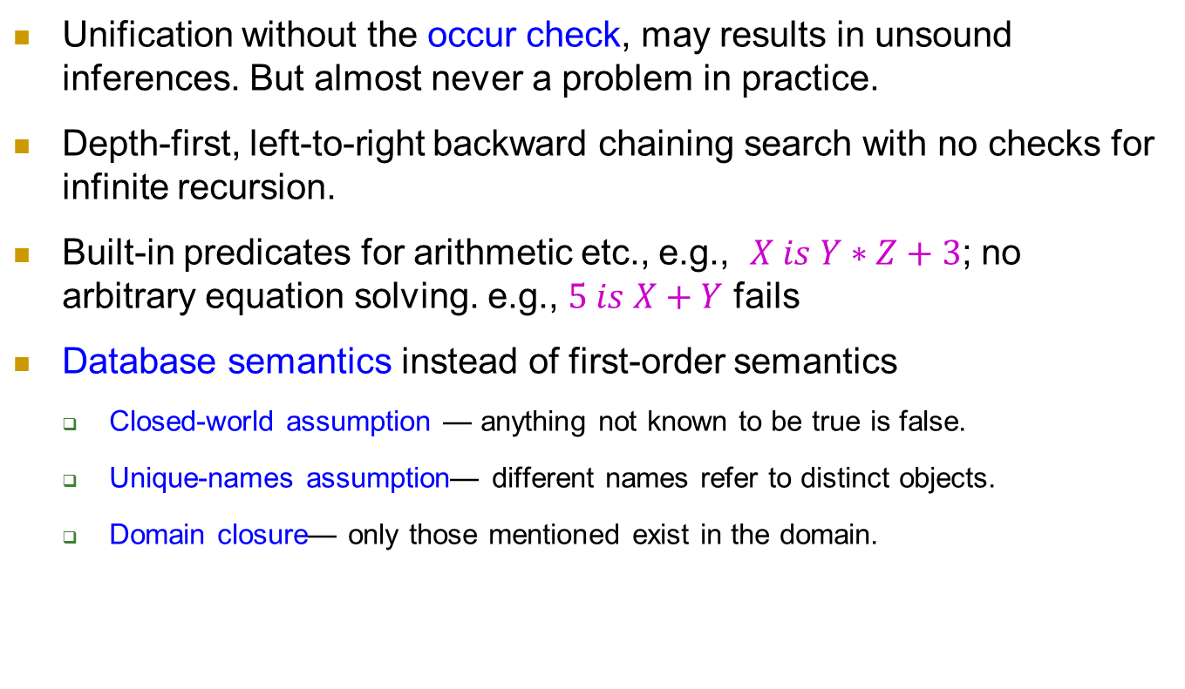
Prolog systems
Unification without the occur check, may results in unsound inferences. But almost never a problem in practice.
Depth-first, left-to-right backward chaining search with no checks for infinite recursion.
Built-in predicates for arithmetic etc., e.g., $X is Y∗Z+3$; no arbitrary equation solving. e.g., $5 is X+Y$ fails
Database semantics instead of first-order semantics
Closed-world assumption — anything not known to be true is false.
Unique-names assumption— different names refer to distinct objects.
Domain closure— only those mentioned exist in the domain.

Slide 48
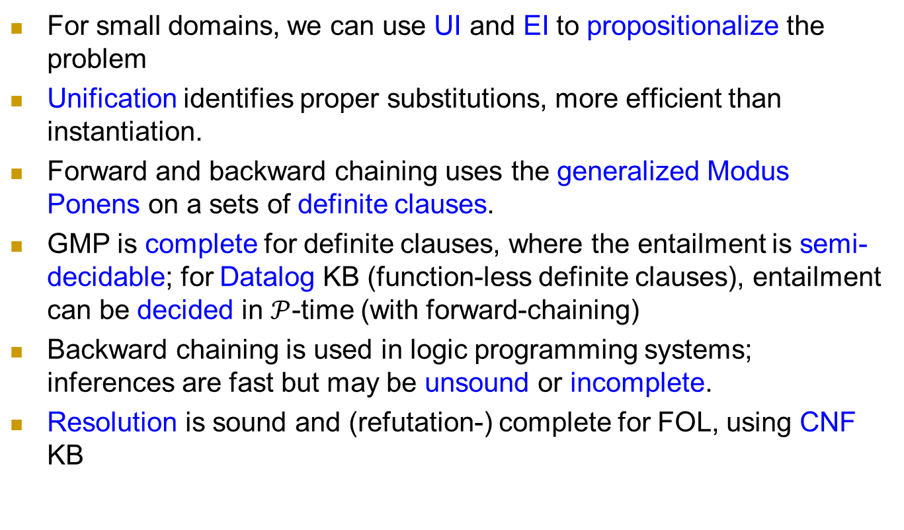
Summary
For small domains, we can use UI and EI to propositionalize the problem
Unification identifies proper substitutions, more efficient than instantiation.
Forward and backward chaining uses the generalized Modus Ponens on a sets of definite clauses.
GMP is complete for definite clauses, where the entailment is semi-decidable; for Datalog KB (function-less definite clauses), entailment can be decided in $𝒫$-time (with forward-chaining)
Backward chaining is used in logic programming systems; inferences are fast but may be unsound or incomplete.
Resolution is sound and (refutation-) complete for FOL, using CNF KB

Slide 49
Homework
member(1,[1,2,3,4,5])
member(3,[1,2,3,4,5]) 要求：给出一个集合，列出其所有元素
subset([2,4],[1,2,3,4,5]) 要求：给出一个集合，列出其所有子集

Slide 50
Homework
事实的集合：有三种事实
is_relation (fact_ID, company_name, time, index-name, value)
supplier (fact_ID, time, company_A, company_B, k, value)
client (fact_ID, time, company_A, company_B, k, value)
检测冲突的事实（facts）
给定一个事实的集合，找出所有“冲突”的fact ID对
思考：什么情形“发生冲突”

